Slide 1


Chapter 4 Network Layer:
The Data Plane
A note on the use of these Powerpoint slides:
We’re making these slides freely available to all (faculty, students, readers). They’re in PowerPoint form so you see the animations; and can add, modify, and delete slides (including this one) and slide content to suit your needs. They obviously represent a lot of work on our part. In return for use, we only ask the following:
Computer Networking: A Top-Down Approach 8th edition Jim Kurose, Keith Ross Pearson, 2020
If you use these slides (e.g., in a class) that you mention their source (after all, we’d like people to use our book!)
If you post any slides on a www site, that you note that they are adapted from (or perhaps identical to) our slides, and note our copyright of this material.
Thanks and enjoy! JFK/KWR
All material copyright 1996-2016
J.F Kurose and K.W. Ross, All Rights Reserved

Slide 2
Chapter 4: network layer
chapter goals:
understand principles behind network layer services, focusing on data plane:
network layer service models
forwarding versus routing
how a router works
addressing
generalized forwarding
instantiation, implementation in the Internet
IP protocol
NAT
Generalized Forwarding and SDN

Slide 3

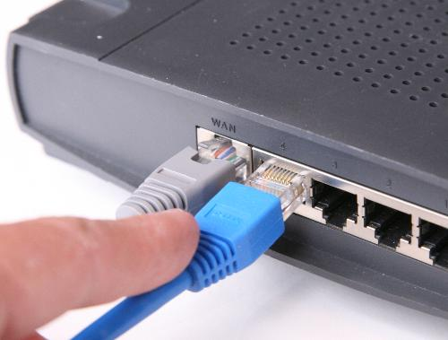
The Network Layer
Overview
Transport layer
Provides various forms of process-to-process communication by relying on the network layer’s host-to-host communication service.
Network layer
Decomposed the network layer into TWO parts: Data Plane (Chapter 4) & Control Plane (Chapter 5)
Can provide its host-to-host communication service.
the most complex layer in the protocol stack.
4-3

Slide 4
Chapter 4: outline
4.1 Overview of Network layer
data plane
control plane
4.2 What’s inside a router
input ports, switching, output ports
4.3 IP: Internet Protocol
datagram format
fragmentation
IPv4 addressing
network address translation (NAT)
IPv6
4.4 Generalized Forwarding and SDN

Slide 5
















Network layer
transport segment from sending to receiving host
on sending side encapsulates segments into datagrams
on receiving side, delivers segments to transport layer
network layer protocols in every host, router
routers
router examines header fields in all IP datagrams passing through it
moves datagrams from input ports to output ports to transfer datagrams along end-end path
application
transport
network
data link
physical
network
data link
physical
network
data link
physical
network
data link
physical
network
data link
physical
network
data link
physical
network
data link
physical
network
data link
physical
network
data link
physical
network
data link
physical
application
transport
network
data link
physical
network
data link
physical
network
data link
physical

Slide 6
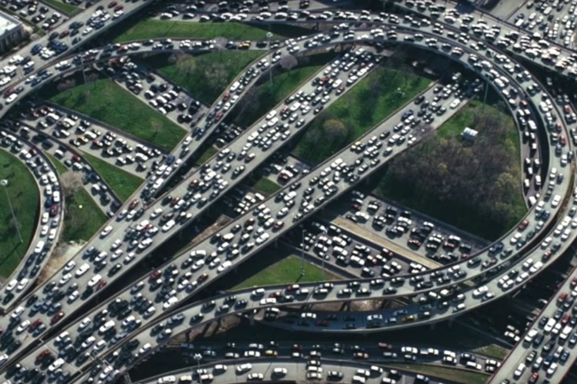
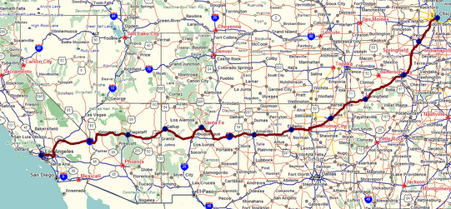
Two key network-layer functions
Two Functions
1st: Forwarding
2nd: Routing
routing
forwarding
Move packets from router’s input to appropriate router output.
Determine route taken by packets from source to destination.
Analogy:
Process of getting through single interchange.
Analogy:
Process of planning trip from source to destination.

Slide 7
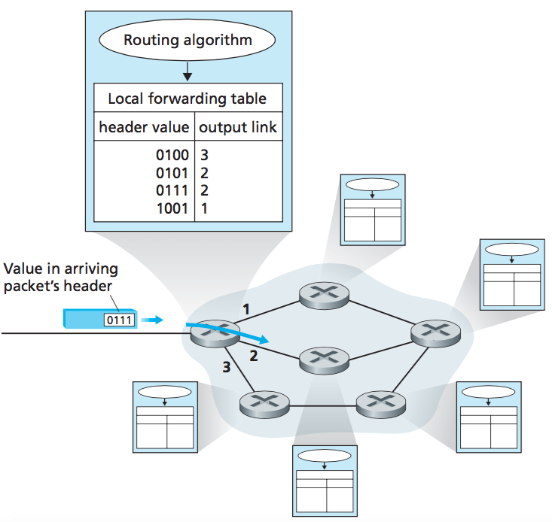
Two key network-layer functions
Interplay between forwarding and routing
Routing:
Determines end-to-end path through network
Forwarding:
Determines local forwarding for this router.
Figure: Routing algorithm determine values in forwarding tables

Slide 8
Network layer: data plane, control plane
Data plane
Forwarding function: Determines how datagram arriving on router input port is forwarded to router output port.
Local, per-router function.
Control plane
Routing function: Determines how datagram is routed among routers along end-end path from source host to destination host.
Network-wide logic.
Two Control-Plane Approaches
Traditional Routing Algorithms
SDN
Implemented in routers.
(Software-Defined Networking SDN)
Implemented in server (remote)
Network Layer: 4-8

Slide 9
Datagram forwarding table
4 billion IP addresses, so rather than list individual destination address,
list range of addresses
(aggregate table entries)
routing algorithm
local forwarding table
dest address
output link
address-range 1
address-range 2
address-range 3
address-range 4
3
2
2
1
32
IPv4:
2 = 4,294,967,296
IP destination address in
arriving packet’s header
1
3
2

Slide 10
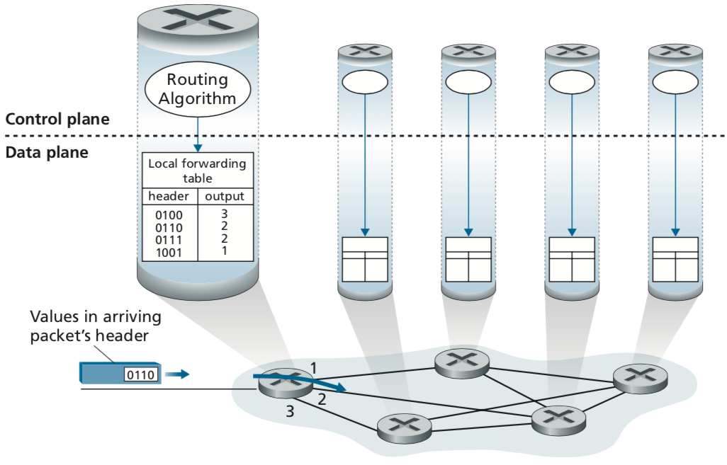
Forwarding and Routing
Per-router control plane
The Traditional Approach
Individual routing algorithm components in each and every router interact in the control plane
Routing:
Determines end-to-end path through network.
Forwarding:
Determines local forwarding of this router.
Figure: Routing algorithm determine values in forwarding tables
Kurose, J.F. and Ross, K.W. (2021). Computer Networking: A Top-Down Approach (8th Edition). Pearson Education Limited, England. (pp. 307)

Slide 11
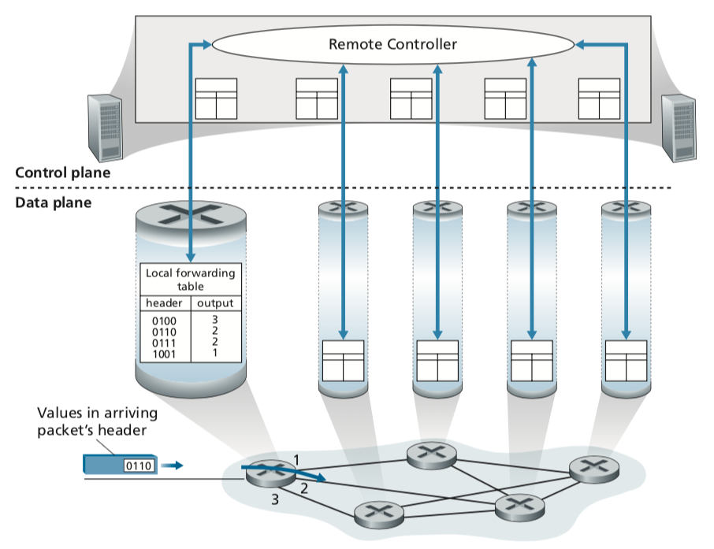
Routing:
Determines end-to-end path through network.
Forwarding and Routing
(b) The SDN Approach
A distinct (typically remote) controller interacts with local control agents (CAs)
Software-Defined Networking (SDN)
Forwarding:
Determines local forwarding of this router.
Figure: A remote controller determines and distributes values in forwarding tables

Slide 12

Routing:
Determines end-to-end path through network.
Forwarding and Routing
(b) The SDN Approach
Software-Defined Networking (SDN)
This SDN will be discussed in the last part of the Network Layer (Chapter 5).
Forwarding:
Determines local forwarding of this router.
Figure: A remote controller determines and distributes values in forwarding tables

Slide 13

Network Service Models
Q: What possible service models that the network layer could provide to transport end-to-end delivery of datagrams from sender to receiver?
guaranteed delivery.
guaranteed delivery with bounded delay (e.g. less than 40 msec delay).
In-order packets delivery.
Guaranteed minimal bandwidth between hosts (e.g. 1 Mbps).
Security (e.g. encryption)
Kurose, J.F. and Ross, K.W. (2021). Computer Networking: A Top-Down Approach (8th Edition). Pearson Education Limited, England. (pp. 309)

Slide 14
Network service model
Q: What service model for “channel” transporting datagrams from sender to receiver?
example services for individual datagrams:
guaranteed delivery
guaranteed delivery with less than 40 msec delay
example services for a flow of datagrams:
in-order datagram delivery
guaranteed minimum bandwidth to flow
restrictions on changes in inter-packet spacing

Slide 15
Network-layer service model
Network
Architecture
Internet
ATM
ATM
Internet
Internet
Quality of Service (QoS) Guarantees ?
Service
Model
best effort
Constant Bit Rate
Available Bit Rate
Intserv Guaranteed
(RFC 1633)
Diffserv (RFC 2475)
Bandwidth
none
Constant rate
Guaranteed min
yes
possible
Loss
no
yes
no
yes
possibly
Order
no
yes
yes
yes
possibly
Timing
no
yes
no
yes
no
Internet “best effort” service model
No guarantees on:
successful datagram delivery to destination
timing or order of delivery
bandwidth available to end-end flow

Slide 16
Network layer service models:
Network
Architecture
Internet
ATM
ATM
ATM
ATM
Service
Model
best effort
CBR
VBR
ABR
UBR
Guarantees ?
Congestion
feedback
no (inferred
via loss)
no
congestion
no
congestion
yes
no
Bandwidth
none
constant
rate
guaranteed
rate
guaranteed
minimum
none
Loss
no
yes
yes
no
no
Order
no
yes
yes
yes
yes
Timing
no
yes
yes
no
no
Asynchronous Transfer Mode (ATM) - Network Architecture
CBR: Constant Bit Rate, VBR=Variable Bit Rate, ABR=Available Bit Rate, UBR= Unspecified Bit Rate

Slide 17
Chapter 4: outline
4.1 Overview of Network layer
data plane
control plane
4.2 What’s inside a router
input ports, switching, output ports
4.3 IP: Internet Protocol
datagram format
fragmentation
IPv4 addressing
network address translation (NAT)
IPv6
4.4 Generalized Forwarding and SDN

Slide 18

Router architecture overview
TWO key router functions:
run routing algorithms / protocol (RIP, OSPF, BGP)
forwarding datagrams from a router’s incoming links to the appropriate outgoing links at a router
Input Ports
Output Ports
Switching Fabric
Routing Processor
Four router components can be identified:
Router
RIP (Routing Information Protocol)
OSPF (Open-Shortest Path First)
BGP (Border Gateway Protocol)
Figure: Four router components

Slide 19
Router architecture overview
high-level view of generic router architecture:
routing, management
control plane (software)
operates in millisecond
time frame
routing
processor
forwarding data plane (hardware) operates in nanosecond timeframe
high-speed
switching
fabric
router input ports
router output ports

Slide 20
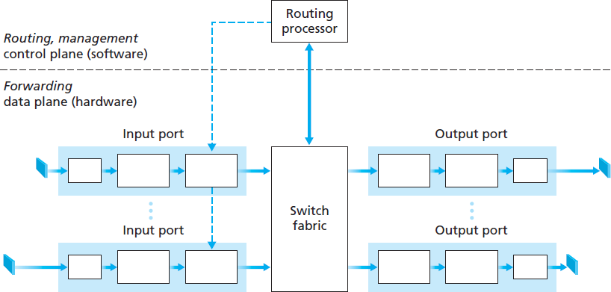
Router architecture overview
The forwarding table (FT) is computed and updated by the routing processor
a shadow copy of
FT is stored at each
input port
Why shadow copy?
forwarding decisions done locally (at input port)
avoiding bottleneck at central processor
forwarded via the
switching fabric
Packet arrives
Lookup performed
in the input port
36

Slide 21
Input port functions
lookup,
forwarding
queueing
line
termination
link
layer
protocol
(receive)
switch
fabric
physical layer:
bit-level reception
data link layer:
e.g., Ethernet
see chapter 6
decentralized switching:
using header field values, lookup output port using forwarding table in input port memory (“match plus action”)
goal: complete input port processing at ‘line speed’
queuing: if datagrams arrive faster than forwarding rate into switch fabric

Slide 22
Input port functions
lookup,
forwarding
queueing
line
termination
link
layer
protocol
(receive)
switch
fabric
physical layer:
bit-level reception
decentralized switching:
using header field values, lookup output port using forwarding table in input port memory (“match plus action”)
destination-based forwarding: forward based only on destination IP address (traditional)
generalized forwarding (SDN): forward based on any set of header field values
data link layer:
e.g., Ethernet
see chapter 5

Slide 23
Destination-based forwarding
forwarding table
Destination Address Range
11001000 00010111 00010000 00000000
through
11001000 00010111 00010111 11111111
11001000 00010111 00011000 00000000
through
11001000 00010111 00011000 11111111
11001000 00010111 00011001 00000000
through
11001000 00010111 00011111 11111111
otherwise
Link Interface
0
1
2
3
Q: but what happens if ranges don’t divide up so nicely?

Slide 24
Longest prefix matching
longest prefix match
when looking for forwarding table entry for given destination address, use longest address prefix that matches destination address.
Destination Address Range
11001000 00010111 00010
11001000 00010111 00011000
11001000 00010111 00011
otherwise
Link interface
0
1
2
3
***
********
********
***
********
examples:
11001000 00010111 00010110 10100001
which interface?
11001000 00010111 00011000 10101010
which interface?

Slide 25
Longest prefix matching
longest prefix match
when looking for forwarding table entry for given destination address, use longest address prefix that matches destination address.
Destination Address Range
11001000 00010111 00010
11001000 00010111 00011000
11001000 00010111 00011
otherwise
Link interface
0
1
2
3
***
********
********
match!
***
********
examples:
11001000 00010111 00010110 10100001
which interface?
11001000 00010111 00011000 10101010
which interface?

Slide 26
Longest prefix matching
longest prefix match
when looking for forwarding table entry for given destination address, use longest address prefix that matches destination address.
Destination Address Range
11001000 00010111 00010
11001000 00010111 00011000
11001000 00010111 00011
otherwise
Link interface
0
1
2
3
***
********
********
***
********
match!
examples:
11001000 00010111 00010110 10100001
which interface?
11001000 00010111 00011000 10101010
which interface?

Slide 27
Longest prefix matching
longest prefix match
when looking for forwarding table entry for given destination address, use longest address prefix that matches destination address.
Destination Address Range
11001000 00010111 00010
11001000 00010111 00011000
11001000 00010111 00011
otherwise
Link interface
0
1
2
3
***
********
********
***
********
match!
examples:
11001000 00010111 00010110 10100001
which interface?
11001000 00010111 00011000 10101010
which interface?

Slide 28
Longest prefix matching
we’ll see why longest prefix matching is used shortly, when we study addressing
longest prefix matching: often performed using ternary content addressable memories (TCAMs)
content addressable: present address to TCAM: retrieve address in one clock cycle, regardless of table size
Cisco Catalyst: can up ~1M routing table entries in TCAM

Slide 29
Switching Fabrics
Transfer packet from input buffer to appropriate output buffer.
Switching rate: rate at which packets can be transfer from inputs to outputs
often measured as multiple of input/output line rate.
N inputs: switching rate = N times line rate desirable.
Switching Fabrics
Memory
Bus
Crossbar
Figure: Three type of switching fabrics techniques

Slide 30
Switching fabrics
transfer packet from input buffer to appropriate output buffer
switching rate: rate at which packets can be transfer from inputs to outputs
often measured as multiple of input/output line rate
N inputs: switching rate N times line rate desirable
three types of switching fabrics
memory
memory
bus
crossbar

Slide 31
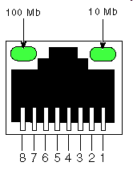
Switching via memory
first generation routers:
traditional computers with switching under direct control of CPU
packet copied to system’s memory
speed limited by memory bandwidth (2 bus crossings per datagram)
input
port
(e.g.,
Ethernet)
output
port
(e.g.,
Ethernet)
memory
system bus

Slide 32
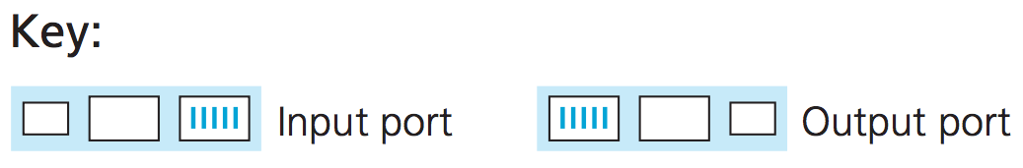
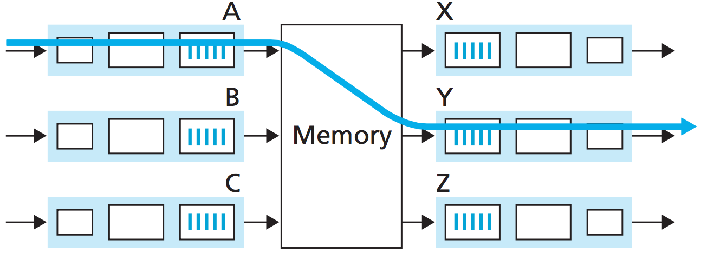
Switching via memory
Switching Fabrics
Processor copy
datagram into Memory
Datagram
arrives
Check Dest
Lookup FT
Copy datagram
to output port

Slide 33
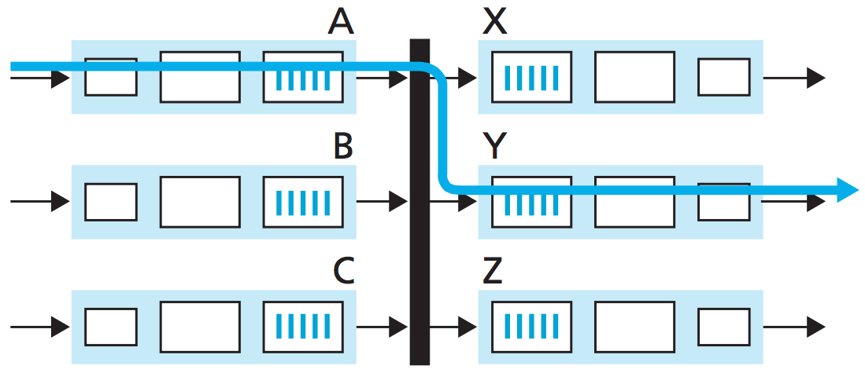
Switching via a bus
datagram from input port memory
to output port memory via a shared bus
bus contention: switching speed limited by bus bandwidth
32 Gbps bus, Cisco 5600: sufficient speed for access and enterprise routers
bus

Slide 34
Switching via a bus
Datagram gets
on bus
Datagram arrives
Datagram gets switch label
The correct output port get it → strip label → send on its ways

Slide 35
Switching via interconnection network (crossbar)
overcome bus bandwidth limitations
banyan networks, crossbar, other interconnection nets initially developed to connect processors in multiprocessor
advanced parallelism design:
fragmenting datagram into fixed length cells on entry
switch cells through the fabric, reassemble datagram at exit
Cisco 12000: switches 60 Gbps through the interconnection network
crossbar

Slide 36
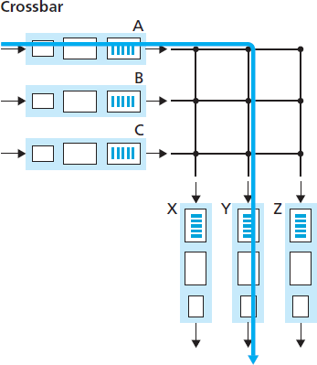
Switching via interconnection network (crossbar)
Check dest. (Y)
Datagram arrives
Close A-Y → put datagram on bus
Y picks up
datagram
45

Slide 37
Input port queuing
fabric slower than input ports combined -> queueing may occur at input queues
queueing delay and loss due to input buffer overflow!
Head-of-the-Line (HOL) blocking: queued datagram at front of queue prevents others in queue from moving forward
switch
fabric
switch
fabric
output port contention:
only one red datagram can be transferred. lower red packet is blocked
one packet time later: green packet experiences HOL blocking

Slide 38
Output port queuing
datagram
buffer
queueing
switch
fabric
link
layer
protocol
(send)
line
termination
buffering required when datagrams arrive from fabric faster than the transmission rate
scheduling discipline chooses among queued datagrams for transmission
Datagram (packets) can be lost due to congestion, lack of buffers
Priority scheduling – who gets best performance, network neutrality

Slide 39
Output port queueing
switch
fabric
switch
fabric
at t, packets more
from input to output
one packet time later
buffering when arrival rate via switch exceeds output line speed
queueing (delay) and loss due to output port buffer overflow!

Slide 40
How much buffering?
RFC 3439 rule of thumb:
average buffering size = RTT * link capacity C
e.g., RTT=250 msec (“typical”), C = 10 Gpbs link
average buffering size =250 msec * 10 Gpbs
= 2.5 Gbit buffer
recent recommendation: with N flows, buffering equal to
.
RTT C
N

Slide 41
Exercise
Supposed the link capacity for a router is 20Mbps and RTT for a packet is 400msec.
If the TCP flow of packets is 16, calculate the buffering needed for the router.
Solution:
Link capacity, C = 20Mbps
RTT = 400msec
TCP flows, N = 16
Buffer size,

Slide 42
Chapter 4: outline
4.1 Overview of Network layer
data plane
control plane
4.2 What’s inside a router
input ports, switching, output ports
4.3 IP: Internet Protocol
datagram format
fragmentation
IPv4 addressing
network address translation (NAT)
IPv6
4.4 Generalized Forwarding and SDN

Slide 43
The Internet network layer
host, router network layer functions:
transport layer: TCP, UDP
routing protocols
path selection
RIP, OSPF, BGP
IP protocol
addressing conventions
datagram format
packet handling conventions
network
layer
forwarding
table
ICMP protocol
error reporting
router “signaling”
link layer
physical layer
RIP (Routing Information Protocol)
OSPF (Open Shortest path First)
BGP (Border Gateway Protocol)

Slide 44
IP datagram format
IP protocol version
number
32 bits
total datagram
length (bytes)
header length
(bytes)
head.
len
type of
service
ver
length
for
fragmentation/
reassembly
“type” of data
flgs
fragment
offset
16-bit identifier
max number
remaining hops
(decremented at
each router)
time to
live
upper
layer
header
checksum
32 bit source IP address
upper layer protocol
to deliver payload to
32 bit destination IP address
options (if any)
e.g. timestamp,
record route
taken, specify
list of routers
to visit.
data
(variable length,
typically a TCP
or UDP segment)

Slide 45
IP datagram format
Understanding datagram format is important
A datagram has its own header (overhead) ➔ 20 bytes
A datagram holds TCP/UDP segment within it ➔ TCP/UDP has own overhead
How much overhead?
20 bytes of TCP
20 bytes of IP
= 40 bytes + app layer overhead
Notes:
Recall that a network-layer packet is referred to as a datagram

Slide 46
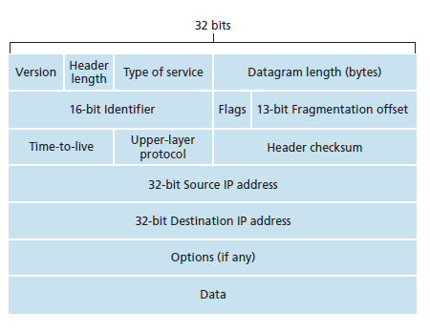
IP datagram format
IPv4 Datagram Format
20 bytes

Slide 47

IP fragmentation, reassembly
network links have MTU (max.transfer size) - largest possible link-level frame
different link types, different MTUs
Ethernet MTU 1500 bytes
large IP datagram divided (“fragmented”) within net
one datagram becomes several datagrams
“reassembled” only at final destination
IP header bits used to identify, order related fragments
…
fragmentation:
in: one large datagram
out: 3 smaller datagrams
reassembly
…

Slide 48
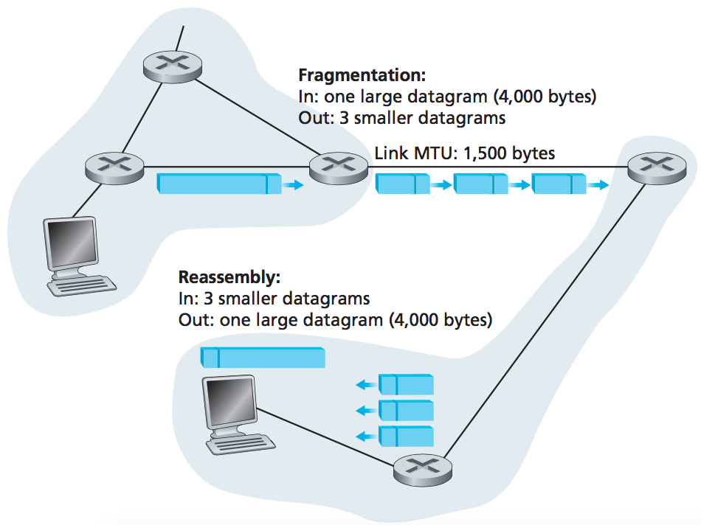
IP fragmentation, reassembly
IP fragmentation, reassembly
Original datagram :
4000 bytes
= 20 bytes of IP header
+ 3,980 bytes of IP payload
Fragmentation:
= 4000 / 1500 bytes
= 3 datagrams
Reassembly:

Slide 49
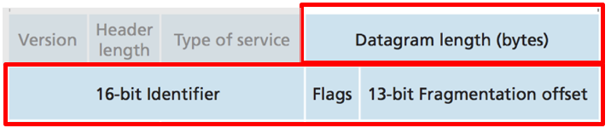
IP fragmentation, reassembly
IP fragmentation, reassembly
Fragment #1
length=1500 ID=777 flag=1 offset=0
Fragment #2
length=1500 ID=777 flag=1 offset=185
Fragment #3
length=1040 ID=777 flag=0 offset=370

Slide 50
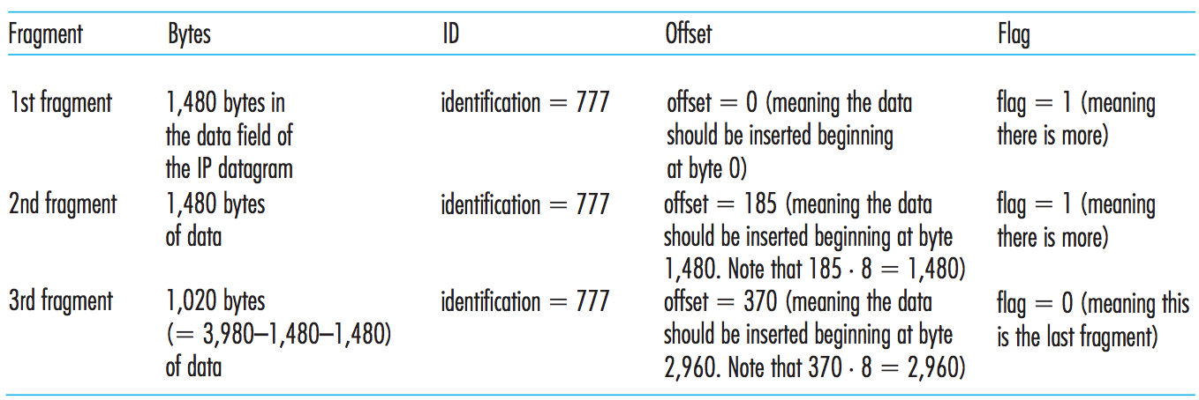
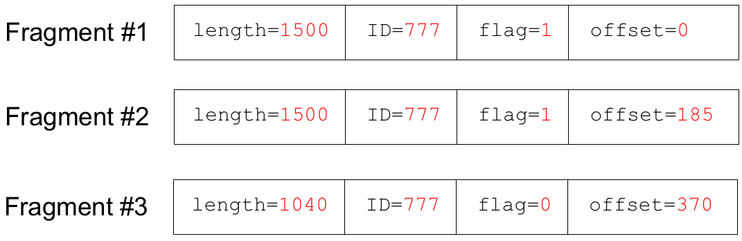
IP fragmentation, reassembly
IP fragmentation, reassembly
Data (1480) + Header (20) = 1500 bytes
Why 1480 not 1500?
offset:
0
8
...
1472
1480
...
2952
2960
...
3980
Fragment 1
0
185
370
Fragments of same datagram
Offset value specified in units of 8-byte chunks
Fragment 2
Fragment 3

Slide 51
Exercise
A datagram of 5000 bytes arrived at a router and must be forwarded to a link with an MTU of 1500 bytes. Suppose that the original datagram is stamped with an identification number of 333. Draw all IP fragments generated after fragmentation that reflect the requirement of original payload data in the datagram.
Datagram
length=5000 ID=333 flag=0 offset=0

Slide 52
Solution
Solution:
20 header + 4980 data
Datagram
length=5000 ID=333 flag=0 offset=0
Total fragments = 5000 / 1500 = 4
4980 = 1480 + 1480 + 1480 + 540
Fragment#1
length=1500 ID=333 flag=1 offset=0
Fragment#2
length=1500 ID=333 flag=1 offset=185
Fragment#3
length=1500 ID=333 flag=1 offset=370
Fragment#4
length= 560 ID=333 flag=0 offset=555

Slide 53
Chapter 4: outline
4.1 Overview of Network layer
data plane
control plane
4.2 What’s inside a router
input ports, switching, output ports
4.3 IP: Internet Protocol
datagram format
fragmentation
IPv4 addressing
network address translation (NAT)
IPv6
4.4 Generalized Forwarding and SDN

Slide 54
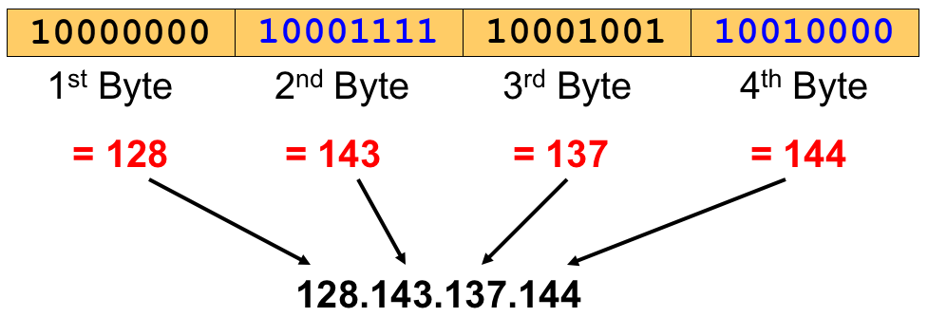
IPv4 Addressing
What is an IP Address?
IP address is used to identify a host within a network.
are written in a so-called dotted decimal notation
Each byte is identified by a decimal number in the range [0…255]:
Example:

Slide 55
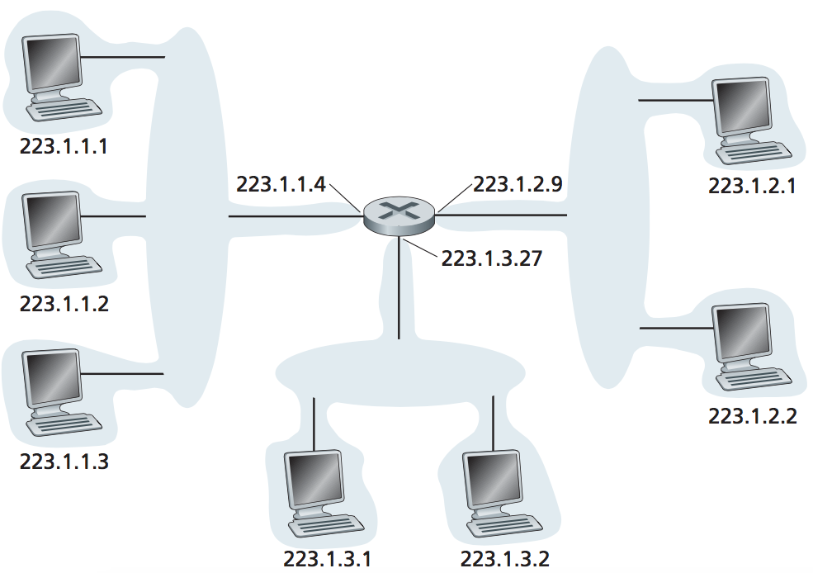
IPv4 Addressing
Addresses
IP address: 32-bit identifier for host, router interface
Interface: connection between host/router and physical link.
router's typically have multiple interfaces.
host typically has one or two interfaces. (e.g., wired Ethernet, wireless 802.11)
One IP address associated with each interface !

Slide 56
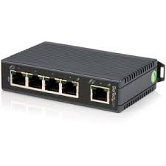
IPv4 Addressing
Addresses
Q: How are interfaces
actually connected?
A: wired Ethernet interfaces connected by Ethernet switches (Link Layer)
A: wireless WiFi interfaces connected by WiFi base station (AP – access point)

Slide 57
IPv4 Addressing – Subnet/Subnetting
Notes:
STOP HERE!!! Sec 01 – 17.04.17 ( Monday ) ; 4pm

Slide 58
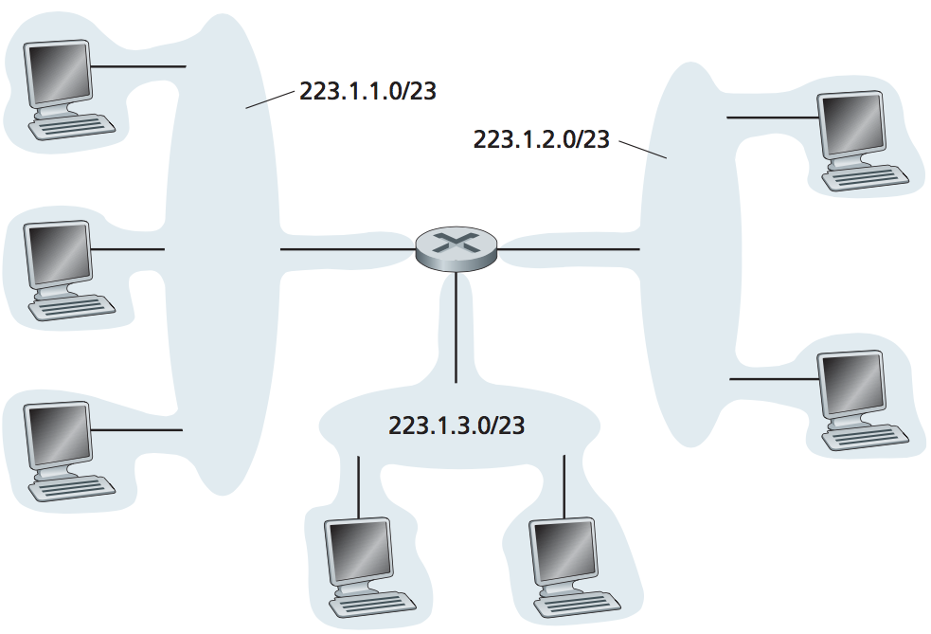
IPv4 Addressing
Subnets
Interconnecting three host interfaces and one router interface forms a subnet.
What’s a subnet ?
Subnet or subnetwork is a logical, visible subdivision of an IP network.
The practice of dividing a network into two or more networks is called subnetting.

Slide 59
IPv4 Addressing
Subnets
A subnet is a group of host identified with having the same portion of their IP address
Example:
223.1.1.1, 223.1.1.2, 223.1.1.3, 223.1.1.4, …
223.1.1.1, 223.1.1.2, 223.1.1.3, 223.1.1.4, …
This portion is indicated by the subnet mask with notation /24
Subnet mask defines the subnet address
➙ 223.1.1.0/24
223.1.1.0/24
223.1.2.0/24
223.1.3.0/24
Network consisting of 3 subnet addresses

Slide 60
IPv4 Addressing
Subnet Mask
A computer OR a router must be able to identify whether a host with a given IP address is on its subnet or not.
The subnet mask is:
used to separate the network portion of an IP address from the host portion.
a set of 32 bits IP address which the bits in the network portion of the address are set to 1s and the host portion is set to 0s.

Slide 61
IPv4 Addressing
Subnet Mask
IP address with w.x.y.z /24 address.
8 bits 8 bits 8 bits 8 bits
11111111
11111111
11111111
00000000
Network portion
Host portion
Thus, subnet mask = 255.255.255.0

Slide 62
IPv4 Addressing
Subnet Mask
Each IP address can be divided into network portion and host portion
Network portion (indicated by subnet mask)
all host with same network portion are in the same subnet
these host can physically reach each other without intervening router
Host portion (the remaining bits → {32 bit – subnet mask })
The individual (unique) address for a host
Example: 192.64.22.31/24
192
64
22
31
11000000 . 01000000 . 00010110 . 00011111
Network portion
Host portion

Slide 63
IPv4 Addressing
192.64.22.31/24
192
64
22
31
11000000 . 01000000 . 00010110 . 00011111
Network portion
Host portion
Given the information we find that:
The host has 8 bits →
this subnet can have up to 2⁸ = 256 hosts
With IP addresses ranging from 192.64.22.0 – 192.64.22.255
But the first and last IP address cannot be assigned to host
so only 254 hosts available (or usable)
…thus useable IP addresses → 192.64.22.1 – 192.64.22.254
The first IP – the network address → to address the subnet
The last IP – the broadcast address → used to broadcast info throughout the subnet

Slide 64
IPv4 Addressing
Given an IP address and subnet mask, we can find the network address and broadcast address …
Example: IP address = 192.168.1.10/24
Set the host portion as all zero(0) to get network address
Set the host portion as all one(1) to get broadcast address
192.168.1.10
Network address: 192.168.1.0
192.168.1.[00000000]
192.168.1.[11111111]
Broadcast address: 192.168.1.255

Slide 65
IPv4 Addressing
Example
Subnets Mask
Convert these subnet mask into decimal values.
(a) /8
(b) /16
(c) /24
(d) /25
11111111.00000000.00000000.00000000
255.0.0.0
11111111.11111111.00000000.00000000
255.255.0.0
11111111.11111111.11111111.00000000
255.255.255.0
11111111.11111111.11111111.10000000
255.255.255.128

Slide 66
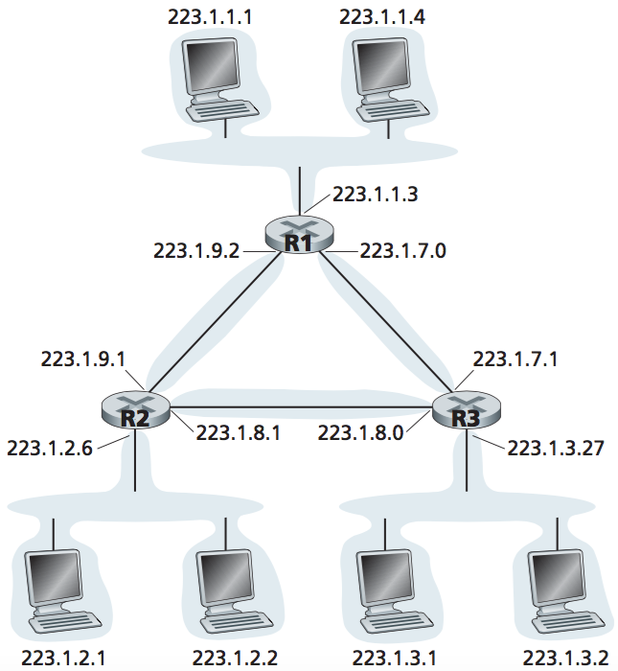
IPv4 Addressing
Subnets Mask
To determine subnet address:
IP address AND subnet mask
223.1.1.0/24
Example:
If the subnet mask is 255.255.255.0, define the subnet address.
(AND)
223. 1 . 1 .4
AND 255.255.255.0
11011111.00000001.00000001.00000100
11111111.11111111.11111111.00000000
11011111.00000001.00000001.00000000
223.1.1.0/24

Slide 67
IPv4 Addressing
Self-Test
If the subnet mask is 255.255.255.0, define all the subnet addresses with the subnet mask.
223.1.1.0/24
Solutions:
223. 1 .x .y
AND 255.255.255.0
223.1.2.0/24
223.1.3.0/24

Slide 68


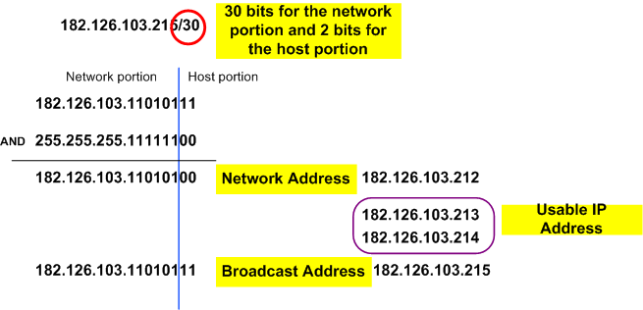
IPv4 Addressing
Example
182.126.103.215/30
Network portion of the address DOES NOT CHANGE.

Slide 69
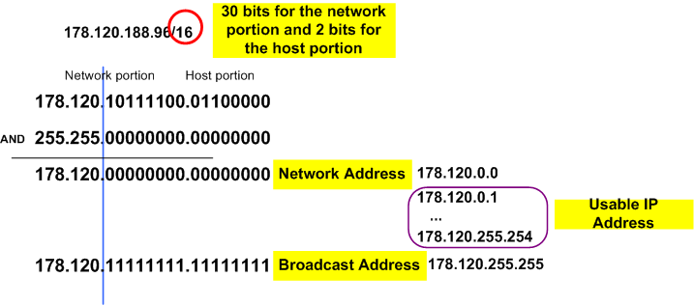
IPv4 Addressing
Example
178.120.188.96/16
16 bits for the network portion and 16 bits for host portion
Network portion of the address DOES NOT CHANGE.

Slide 70
Class Exercise
Given these IP addresses, determine the network portion and the host portion
192.168.12.0/24
192.168.12.25/25
172.16.32.0/16
172.16.32.0/20
10.10.10.0/8
In-class try out ...

Slide 71
IPv4 Addressing – Type of Addressing
Notes:
STOP HERE!!! Sec 01 – 17.04.17 ( Monday ) ; 4pm

Slide 72
How to get an IP address?
Type of Addressing
Classful ( old one)
Classless ( current)

Slide 73
How to get an IP address?
In the beginning, addressing scheme known as classful addressing →
where IP blocks were given according to size
Class A – big size of organization
Class B – medium size of organization
Class C – small size of organization

Slide 74
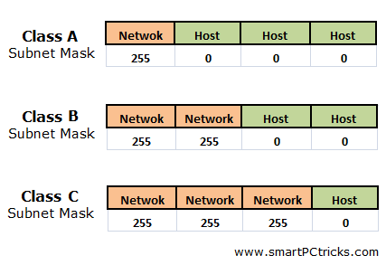
How to get an IP address?
Classful addressing

Slide 75
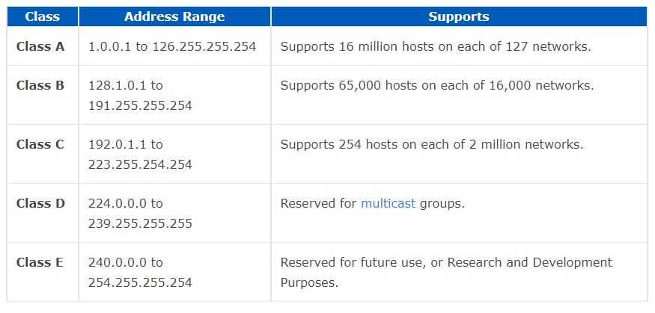
How to get an IP address?
Classful addressing
/8 255.0.0.0
/16 255.255.0.0
/24 255.255.255.0

Slide 76
How to get an IP address?
Classful addressing
Example:
An organization needs 2000 hosts and apply class B
Class B allocated 65000 addresses, and leaving more than 63000 not used.
PROBLEMS: Wasted addresses and not optimized
Large organizations do not fully utilize the IP address they have
Had problem supporting the rapidly growing number of organizations with small and medium-sized subnets

Slide 77
How to get an IP address?
Classless Inter Domain Routing (CIDR)
more flexible than original system of internet address scheme ( i.e. classful addressing)
can avoid situations where large numbers of IP addresses are unused
address format: a.b.c.d/x
where x is no. of bits in subnet portion of address often referred to as prefix
200.23.16.0/23
11001000.00010111.00010000.00000000
Subnet part
host
part
Network part
subnet portion of address is arbitrary length

Slide 78
How to get an IP address?
Classless Inter Domain Routing (CIDR)
Example:
An organization needs 2000 hosts and apply for IP address
Host needed is 2000 → 2¹¹ = 2048 (i.e. only extra 48)
Thus an IP address→ 163.44.224.0/21 is given
How we get … /21 ? → 32 – 11 = 21
21 bits 11 bits
11111111
11111111
11111
00000000000
Network portion
Host portion

Slide 79
Subnetting: To subnet a small network
Q: How does a network get subnets part of an IP address?
A: by subnetting the given IP address
Example: 200.23.16.0/20 to be divided into 8 subnets (2³).
need to borrow 3 bits
from host portion
to define 8 subnets
ISP’s block:
200.23.16.0/20 →
Network portion
Host portion
11001000.00010111.00010000.00000000
Subnet 0:
200.23.16.0/23 →
11001000.00010111.00010000.00000000
Subnet 1:
200.23.18.0/23 →
11001000.00010111.00010010.00000000
…
Subnet 7:
200.23.30.0/23 →
...
11001000.00010111.00011110.00000000

Slide 80
Example: To subnet a small network
Say, Company A (CA) is given the IP address 192.168.1.0/24
CA has 4 departments under it:
RND,
Sales,
Finance,
Human Resource (HR)
CA decided to divide the network according to purpose. So, the network needs to have 4 major subnets.

Slide 81
Example: To subnet a small network
192.168.1.0/24 to be divided into 4 subnets
192.168.1.0/24 →
11000000.10101000.00000001.00000000

Slide 82
Example: To subnet a small network
192.168.1.0/24 to be divided into 4 subnets
Network portion
Host portion
192.168.1.0/24 →
11000000.10101000.00000001.00000000
Subnet address: →
11000000.10101000.00000001.00000000
need to borrow 2 bits
from host portion
to define 4 subnets
(i.e. 2²)

Slide 83
Example: To subnet a small network
192.168.1.0/24 to be divided into 4 subnets
Network portion
Host portion
192.168.1.0/24 →
11000000.10101000.00000001.00000000
Subnet address: →
11000000.10101000.00000001.00000000
Subnet 0: →
192.168.1.0/26
11000000.10101000.00000001.00000000
6 bit left for host
The subnet mask for each subnet
is /26 OR 255.255.255.192

Slide 84
Example: To subnet a small network
Subnet 0: →
192.168.1.0/26
11000000.10101000.00000001.00000000
192.168.1.[ 00 000000 ]
.[ 00 111111 ]
.[ 01 000000 ]
.[ 01 111111 ]
.[ 10 000000 ]
.[ 10 111111 ]
.[ 11 000000 ]
.[ 11 111111 ]
subnet 0
subnet 1
subnet 2
subnet 3

Slide 85
Example: To subnet a small network
Subnet 0: →
192.168.1.0/26
11000000.10101000.00000001.00000000
192.168.1.[ 00 000000 ]
.[ 00 111111 ]
.[ 01 000000 ]
.[ 01 111111 ]
.[ 10 000000 ]
.[ 10 111111 ]
.[ 11 000000 ]
.[ 11 111111 ]
subnet 0; network address = 192.168.1.0
subnet 1; network address = 192.168.1.64
subnet 2; network address = 192.168.1.128
subnet 3; network address = 192.168.1.192

Slide 86
Example: To subnet a small network
Subnet 0: →
192.168.1.0/26
11000000.10101000.00000001.00000000
192.168.1.[ 00 000000 ]
.[ 00 111111 ]
.[ 01 000000 ]
.[ 01 111111 ]
.[ 10 000000 ]
.[ 10 111111 ]
.[ 11 000000 ]
.[ 11 111111 ]
subnet 0; broadcast address = 192.168.1.63
subnet 1; broadcast address = 192.168.1.127
subnet 2; broadcast address = 192.168.1.191
subnet 3; broadcast address = 192.168.1.255

Slide 87
Example: To subnet a small network
Subnet 0: →
192.168.1.0/26
11000000.10101000.00000001.00000000
192.168.1.[ 00 000000 ]
.[ 00 111111 ]
.[ 01 000000 ]
.[ 01 111111 ]
.[ 10 000000 ]
.[ 10 111111 ]
.[ 11 000000 ]
.[ 11 111111 ]
00 000001 - first host
00 111110 – last host
10 000001 – first host
10 111110 – last host

Slide 88
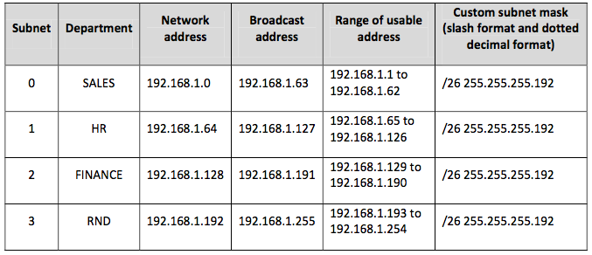
Example: To subnet a small network
192.168.1.0/24 be divided into 4 subnets we get:

Slide 89
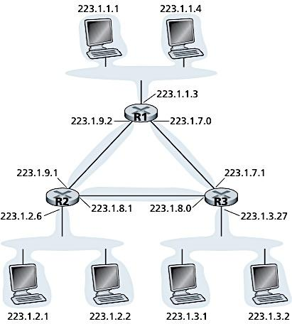
Self study
Exercise 4.2
A
B
Given a network with hosts and interconnecting routers.
What are the subnet mask addresses for the network that consists of host A, B, D, and E?
What is the subnet address of network X if the subnet mask address is 255.0.0.0?
Get a valid IP address for each host A, B, D, E and G.
Get a valid IP address for each router’s interface at C and F.
200.1.0.0/16
C
F
161.139.2.0/24
X
D E G
10.90.2.1

Slide 90
Self study
Solution 4.2
A
B
Net. consists of host A, B:
255.255.0.0
Net. consists of host D, E:
255.255.255.0
(b) 10.90.2.1
255. 0.0.0
10. 0.0.0
Valid IP address:
A: 200.1.0.100
B: 200.1.50.88
D: 161.139.2.4
E: 161.139.2.100
G: 10.92.5.25
(d) Valid IP address:
C: 200.1.0.1
F: 161.139.2.1
200.1.0.0/16
C
F
161.139.2.0/24
X
D E G
10.90.2.1

Slide 91
Self study
Exercise 4.3
Given an IP address as 200.23.0.0/20. The network need to be divided into 5 subnets with first subnet label as subnet#0.
What is the subnet mask for the given IP address?
How many hosts can be supported?
List all subnets.
What is the new subnet mask for each subnet?
How many hosts can be supported for each subnet?
List the first 5 valid IP addresses for the subnet#3.
How many subnet remain unused and can be utilized in future?

Slide 92
Self study
Solution 4.3
0. 0000 0001
1. 1111 1110
Solutions:
11111111.11111111.11110000.00000000
255.255.240.0
(b) Total hosts → 2¹² – 2 = 4096 – 2 = 4094 hosts
(c) Subnet 5 → 2³ = 8 subnet; 3 bits more for subnet;
11001000.00010111.00000000.00000000 (200.23.0.0/23)
11001000.00010111.00000010.00000000 (200.23.2.0/23)
11001000.00010111.00000100.00000000 (200.23.4.0/23)
11001000.00010111.00000110.00000000 (200.23.6.0/23)
11001000.00010111.00001000.00000000 (200.23.8.0/23)
11001000.00010111.00001010.00000000 (200.23.10.0/23)
11001000.00010111.00001100.00000000 (200.23.12.0/23)
11001000.00010111.00001110.00000000 (200.23.14.0/23)

Slide 93
Self study
Solution 4.3
Solutions:
(d) 11111111.11111111.11111110.00000000
255.255.254.0
(e) Total hosts in subnet → 2⁹ = 512 – 2 = 510 hosts;
(f) Subnet #3 = 200.23.6.0/23
11001000.00010111.00000110.00000000 (200.23.6.0/23)
11001000.00010111.00000110.00000001 (200.23.6.1/23)
11001000.00010111.00000110.00000010 (200.23.6.2/23)
11001000.00010111.00000110.00000011 (200.23.6.3/23)
11001000.00010111.00000110.00000100 (200.23.6.4/23)
11001000.00010111.00000110.00000101 (200.23.6.5/23)
(g) Need = 5 subnets, generated subnets = 8, extra = 8 – 5 = 3 subnets

Slide 94
Extra Exercise (Same/Equal Size) : Subnet small network
Say, Company A (CA) is given the Network address 192.168.1.0/24
CA has 4 departments under it: RND, Sales, Finance, HR
Each department needs the following number of usable host: RND(50), Sales(30), Finance(20), HR(10)
Task:
Divide equally for all dept. (same/equal size)

Slide 95
Network address 192.168.1.0/24
to divide into SAME/EQUAL SIZED 4 dept : RND, SALES, FIN, HR
STEP 1 : Divide the Network and host portion
192 . 168 . 1 . 0
11000000 . 10101000.00000001.00000000
NP = 24 bits
**when subnetting ONLY HOST PORTION
is borrowed from (disturbed)
STEP 2 : Decide how many bits need to BORROW from HP?
4 depts. ➔ 4 subnet
So 2^{x} = 4 ➔ x = 2 bits
Borrow 2 bits

Slide 96
Network address 192.168.1.0/24
to divide into SAME/EQUAL SIZED 4 dept : RND, SALES, FIN, HR
Borrow from this end – THE LEFTMOST
STEP 3 : Borrow 2 bits from the host portion
192 . 168 . 1 . 0
11000000 . 10101000.00000001.00000000
Within the subnet , the HP gets all 0 and all 1
STEP 4 : Arrange the new subnets
192 . 168 . 1 . 0
11000000 . 10101000.00000001.00000000 [0]
.00111111 [63]
.01000000 [64]
.01111111 [127]
.10000000 [128]

Slide 97
Network address 192.168.1.0/24
to divide into SAME/EQUAL SIZED 4 dept : RND, SALES, FIN, HR
S0 Network Add
STEP 4 : Arrange the new subnets
192 . 168 . 1 . 0
11000000 . 10101000.00000001.00000000
S0 Broadcast Add
S0
.00111111
.01 000000
.01 111111
.10 000000
.10 111111
.11 000000
.11 111111
S0 (subnet 0)
network address:
192.168.1.0
Broadcast address:
192.168.1.63
S1
S2
S3

Slide 98
Network address 192.168.1.0/24
to divide into SAME/EQUAL SIZED 4 dept : RND, SALES, FIN, HR
S0 (subnet 0)
Usable/valid IP address:
192.168.1.1 to
192.168.1.62
STEP 5 : Assign the new subnets
192 . 168 . 1 . 0
11000000 . 10101000.00000001.00000000
000001
111110
S0 - RND
.00111111
.01 000000
.01 111111
.10 000000
.10 111111
.11 000000
.11 111111
000001
111110
S1 - SALES
000001
111110
S2 - FIN
000001
111110
S3 - HR

Slide 99
SUBNET | NETWORK ADDRESS | USABLE/VALID IP ADD. RANGE | BROADCAST ADDRESS | SUBNET MASK
0 | 192.168.1.0 | 192.168.1.1 – 192.168.1.62 | 192.168.1.63 | /26 OR 255.255.255.192
1 | 192.168.1.64 | 192.168.1.65 – 192.168.1.126 | 192.168.1.127 | /26 OR 255.255.255.192
2 | 192.168.1.128 | 192.168.1.126 – 192.168.1.190 | 192.168.1.191 | /26 OR 255.255.255.192
3 | 192.168.1.192 | 192.168.1.190 – 192.168.1.254 | 192.168.1.255 | /26 OR 255.255.255.192
Convert calculation in table to binary format for complete understanding

Slide 100


Obtaining a block of addresses
Q: How does an ISP get block of addresses?
A: ICANN: Internet Corporation for Assigned Names and Numbers (http://www.icann.org/)
allocates addresses
manages DNS
assigns domain names, resolves disputes
ICANN allocates addresses to regional Internet registries
like ARIN, RIPE, APNIC, and LACNIC
…which handle the allocation/management of addresses within their regions.

Slide 101
Obtaining a host addresses
Q: How does a host get IP address?
A: host can get IP address from
local ISP (e.g. Telekom, Celcom, U, DiGi, Maxis, etc)
local organization like UTM (…and UTM also subscribe to local ISP, i.e. Time Telekom )

Slide 102
Hierarchical addressing: route aggregation
hierarchical addressing allows efficient advertisement of routing information:
Organization 0
200.23.16.0/23
Organization 1
200.23.18.0/23
“Send me anything
with addresses
beginning
200.23.16.0/20”
Organization 2
200.23.20.0/23
.
Fly-By-Night-ISP
.
.
.
.
Internet
Organization 7
.
200.23.30.0/23
ISPs-R-Us
“Send me anything
with addresses
beginning
199.31.0.0/16”

Slide 103
Hierarchical addressing: more specific routes
ISPs-R-Us has a more specific route to Organization 1
Organization 0
200.23.16.0/23
“Send me anything
with addresses
beginning
200.23.16.0/20”
Organization 2
200.23.20.0/23
.
Fly-By-Night-ISP
.
.
.
.
Internet
Organization 7
.
200.23.30.0/23
ISPs-R-Us
“Send me anything
with addresses
beginning 199.31.0.0/16
or 200.23.18.0/23”
Organization 1
200.23.18.0/23

Slide 104
Dynamic Host Configuration Protocol (DHCP)
In an organization, IP address can be assigned to host
Statically – User manually configure IP address at host (normally done by ‘network admin’)
Dynamically - done using DHCP
DHCP can be configured to assign
the same IP address to a given host each time it connects to the network
OR different IP address each time the host connects to the network.

Slide 105
Dynamic Host Configuration Protocol (DHCP)
Goal: allow host to dynamically obtain its IP address from DHCP server when it joins network
host will lease an IP address, can renew its lease on address in use
allows reuse of addresses (only hold address while connected)
support for mobile users who want to join network
DHCP is a plug-and-play protocol
Makes network admin job easier
Makes network mobility easier too

Slide 106
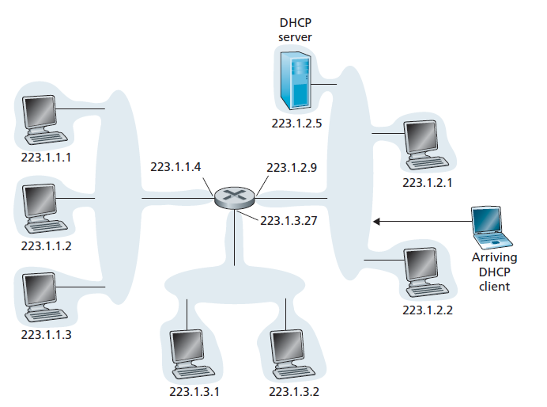
Dynamic Host Configuration Protocol (DHCP)
A newly arriving host, goes through the DHCP protocol four-step process

Slide 107
DHCP – 4 Steps Process
DHCP 4 steps process
DHCP server discovery
DHCP server offer
DHCP request
DHCP ACK
Notes:
DHCP overview:
host broadcasts “DHCP discover” msg [optional]
DHCP server responds with “DHCP offer” msg [optional]
host requests IP address: “DHCP request” msg
DHCP server sends address: “DHCP ack” msg

Slide 108
DHCP – 4 Steps Process
DHCP server discovery
newly arriving host needs to find a DHCP server
→ done by broadcasting the DHCP discover message
source: this host 0.0.0.0
dest: 255.255.255.255 (i.e. broadcast to all)
UDP: Port 67
DHCP server offer
DHCP server(s) will respond to the client with a DHCP offer message that is broadcast to all
A client might receive offers from > 1 DHCP servers

Slide 109
DHCP – 4 Steps Process
DHCP request
Client choose from among the offers
Respond to its selected offer with a DHCP request message.
DHCP ACK
The server responds to the DHCP request message with a DHCP ACK message, confirming the requested parameters.
Notes:
In DHCP request message, the client echoes back the configuration parameters.
DHCP can return more than just allocated IP address on subnet:
address of first-hop router for client
name and IP address of DNS sever
network mask (indicating network versus host portion of address)

Slide 110
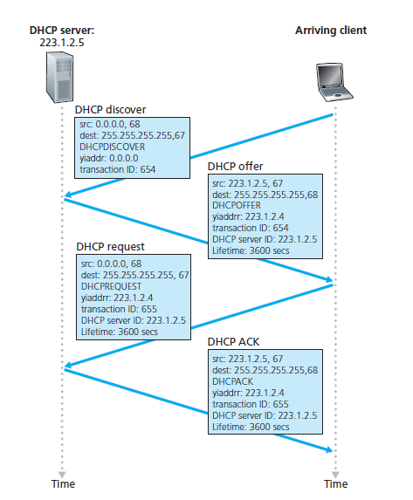
DHCP – 4 Steps Process
yiaddr = your IP address

Slide 111

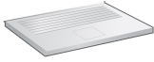
DHCP client-server scenario
DHCP
server
223.1.1.0/24
223.1.1.1
223.1.2.1
223.1.1.2
arriving DHCP
client needs
address in this
network
223.1.1.4
223.1.2.9
223.1.3.27
223.1.2.2
223.1.1.3
223.1.2.0/24
223.1.3.1
223.1.3.2
DHCP can return more than just allocated IP address on subnet:
address of first-hop router for client
name and IP address of DNS sever
network mask (indicating network versus host portion of address)
223.1.3.0/24

Slide 112
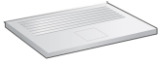
DHCP client-server scenario
DHCP server: 223.1.2.5
DHCP discover
arriving
client
src : 0.0.0.0, 68
dest.: 255.255.255.255,67
yiaddr: 0.0.0.0
transaction ID: 654
Broadcast: is there a DHCP server out there?
DHCP offer
src: 223.1.2.5, 67
dest: 255.255.255.255, 68
yiaddrr: 223.1.2.4
transaction ID: 654
lifetime: 3600 secs
Broadcast: I’m a DHCP server! Here’s an IP address you can use
DHCP request
src: 0.0.0.0, 68
dest:: 255.255.255.255, 67
yiaddrr: 223.1.2.4
transaction ID: 655
lifetime: 3600 secs
Broadcast: OK. I’ll take that IP address!
DHCP ACK
src: 223.1.2.5, 67
dest: 255.255.255.255, 68
yiaddrr: 223.1.2.4
transaction ID: 655
lifetime: 3600 secs
Broadcast: OK. You’ve got that IP address!

Slide 113

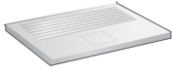
DHCP: example
DHCP
DHCP
UDP
IP
Eth
Phy
connecting laptop needs its IP address, addr of first-hop router, addr of DNS server: use DHCP
DHCP
DHCP
DHCP
DHCP
DHCP request encapsulated in UDP, encapsulated in IP, encapsulated in 802.1 Ethernet
DHCP
DHCP
UDP
IP
Eth
Phy
168.1.1.1
DHCP
DHCP
DHCP
DHCP
router with DHCP
server built into
router
Ethernet frame broadcast (dest: FFFFFFFFFFFF) on LAN, received at router running DHCP server
Ethernet demuxed to IP, IP demuxed to UDP, …last UDP demuxed to DHCP

Slide 114
DHCP: example
DHCP
UDP
IP
Eth
Phy
DHCP server formulates DHCP ACK containing client’s IP address, IP address of first-hop router for client, name & IP address of DNS server
DHCP
DHCP
DHCP
DHCP
encapsulation of DHCP response by DHCP server, frame forwarded to client, demuxing up to DHCP at client
DHCP
DHCP
UDP
IP
Eth
Phy
DHCP
DHCP
DHCP
router with DHCP
server built into
router
DHCP
client now knows its IP address, name and IP address of DNS server, IP address of its first-hop router

Slide 115
DHCP: Example Wireshark output (home LAN)
request
reply
Message type: Boot Request (1)
Hardware type: Ethernet
Hardware address length: 6
Hops: 0
Transaction ID: 0x6b3a11b7
Seconds elapsed: 0
Bootp flags: 0x0000 (Unicast)
Client IP address: 0.0.0.0 (0.0.0.0)
Your (client) IP address: 0.0.0.0 (0.0.0.0)
Next server IP address: 0.0.0.0 (0.0.0.0)
Relay agent IP address: 0.0.0.0 (0.0.0.0)
Client MAC address: Wistron_23:68:8a (00:16:d3:23:68:8a)
Server host name not given
Boot file name not given
Magic cookie: (OK)
Option: (t=53,l=1) DHCP Message Type = DHCP Request
Option: (61) Client identifier
Length: 7; Value: 010016D323688A;
Hardware type: Ethernet
Client MAC address: Wistron_23:68:8a (00:16:d3:23:68:8a)
Option: (t=50,l=4) Requested IP Address = 192.168.1.101
Option: (t=12,l=5) Host Name = "nomad"
Option: (55) Parameter Request List
Length: 11; Value: 010F03062C2E2F1F21F92B
1 = Subnet Mask; 15 = Domain Name
3 = Router; 6 = Domain Name Server
44 = NetBIOS over TCP/IP Name Server
……
Message type: Boot Reply (2)
Hardware type: Ethernet
Hardware address length: 6
Hops: 0
Transaction ID: 0x6b3a11b7
Seconds elapsed: 0
Bootp flags: 0x0000 (Unicast)
Client IP address: 192.168.1.101 (192.168.1.101)
Your (client) IP address: 0.0.0.0 (0.0.0.0)
Next server IP address: 192.168.1.1 (192.168.1.1)
Relay agent IP address: 0.0.0.0 (0.0.0.0)
Client MAC address: Wistron_23:68:8a (00:16:d3:23:68:8a)
Server host name not given
Boot file name not given
Magic cookie: (OK)
Option: (t=53,l=1) DHCP Message Type = DHCP ACK
Option: (t=54,l=4) Server Identifier = 192.168.1.1
Option: (t=1,l=4) Subnet Mask = 255.255.255.0
Option: (t=3,l=4) Router = 192.168.1.1
Option: (6) Domain Name Server
Length: 12; Value: 445747E2445749F244574092;
IP Address: 68.87.71.226;
IP Address: 68.87.73.242;
IP Address: 68.87.64.146
Option: (t=15,l=20) Domain Name = "hsd1.ma.comcast.net."

Slide 116
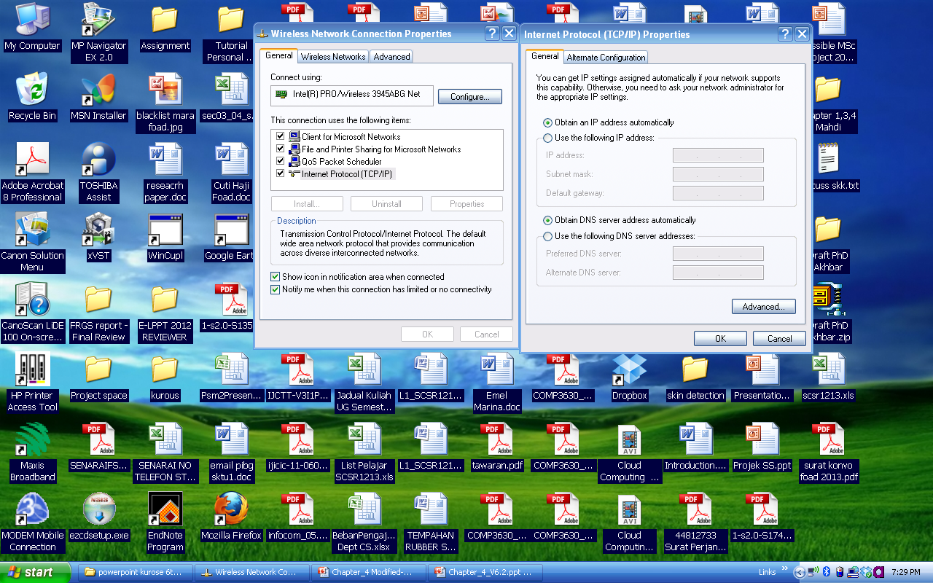
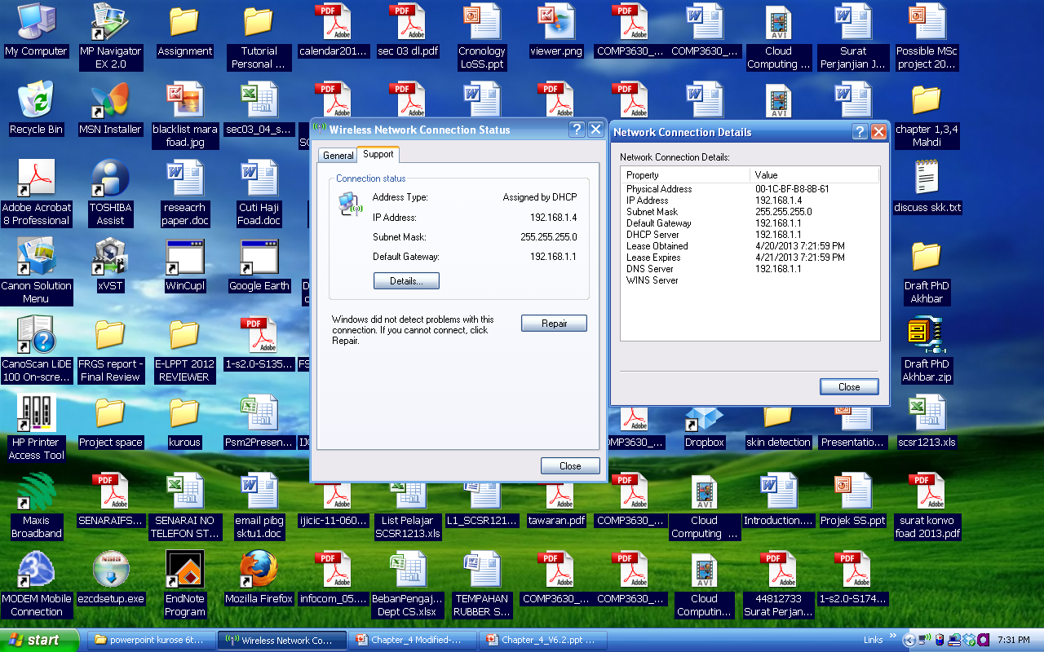
DHCP: Example Assignment (home LAN)
TCP/IP Client Setting
DHCP Server Assignment

Slide 117
Chapter 4: outline
4.1 Overview of Network layer
data plane
control plane
4.2 What’s inside a router
input ports, switching, output ports
4.3 IP: Internet Protocol
datagram format
fragmentation
IPv4 addressing
network address translation (NAT)
IPv6
4.4 Generalized Forwarding and SDN

Slide 118
NAT: network address translation
rest of
Internet
local network
(e.g., home network)
10.0.0/24
10.0.0.1
10.0.0.4
10.0.0.2
138.76.29.7
10.0.0.3
all datagrams leaving local
network have same single source NAT IP address: 138.76.29.7,different source port numbers
datagrams with source or
destination in this network
have 10.0.0/24 address for
source, destination (as usual)

Slide 119
NAT: network address translation
motivation: local network uses just one IP address as far as outside world is concerned:
range of addresses not needed from ISP: just one IP address for all devices
can change addresses of devices in local network without notifying outside world
can change ISP without changing addresses of devices in local network
devices inside local net not explicitly addressable, visible by outside world (a security plus)

Slide 120
NAT: network address translation
implementation: NAT router must:
outgoing datagrams: replace (source IP address, port #) of every outgoing datagram to (NAT IP address, new port #)
. . . remote clients/servers will respond using (NAT IP address, new port #) as destination addr
remember (in NAT translation table) every (source IP address, port #) to (NAT IP address, new port #) translation pair
incoming datagrams: replace (NAT IP address, new port #) in dest fields of every incoming datagram with corresponding (source IP address, port #) stored in NAT table

Slide 121
NAT: network address translation
NAT translation table
WAN side addr LAN side addr
2: NAT router
changes datagram
source addr from
10.0.0.1, 3345 to
138.76.29.7, 5001,
updates table
1: host 10.0.0.1
sends datagram to
128.119.40.186, 80
138.76.29.7, 5001 10.0.0.1, 3345
…… ……
S: 10.0.0.1, 3345
D: 128.119.40.186, 80
10.0.0.1
1
2
S: 138.76.29.7, 5001
D: 128.119.40.186, 80
10.0.0.4
10.0.0.2
138.76.29.7
S: 128.119.40.186, 80
D: 10.0.0.1, 3345
4
S: 128.119.40.186, 80
D: 138.76.29.7, 5001
3
10.0.0.3
4: NAT router
changes datagram
dest addr from
138.76.29.7, 5001 to 10.0.0.1, 3345
3: reply arrives
dest. address:
138.76.29.7, 5001
* Check out the online interactive exercises for more examples: http://gaia.cs.umass.edu/kurose_ross/interactive/

Slide 122
NAT: network address translation
16-bit port-number field:
60,000 simultaneous connections with a single LAN-side address!
NAT is controversial:
routers should only process up to layer 3
address shortage should be solved by IPv6
violates end-to-end argument
NAT possibility must be taken into account by app designers, e.g., P2P applications
NAT traversal: what if client wants to connect to server behind NAT?

Slide 123
Chapter 4: outline
4.1 Overview of Network layer
data plane
control plane
4.2 What’s inside a router
input ports, switching, output ports
4.3 IP: Internet Protocol
datagram format
fragmentation
IPv4 addressing
network address translation (NAT)
IPv6
4.4 Generalized Forwarding and SDN

Slide 124
IPv6: motivation
initial motivation: 32-bit address space soon to be completely allocated. IPv6 provided a larger IP address space → more IP address
additional motivation:
header format helps speed processing/forwarding
header changes to facilitate QoS

Slide 125
IPv6 datagram format
priority: identify priority among datagrams in flow
flow Label:
labeling of packets belonging to particular flows for which the sender requests special handling
Example: real-time service, media streaming
But the real definition of flow is still vague (unclear)
next header: identify upper layer protocol for data
Traffic class:
used to give priority to datagrams
certain datagrams within a flow
datagrams from certain applications (for example, ICMP) over others
Payload length:
What size of data sent (not including header)
If payload is 4bytes → total datagram size = 40 + 4 = 44 bytes

Slide 126
IPv6 datagram format
Used to give priority to certain datagrams
ver
pri
flow label
payload len
next hdr
hop limit
source address
(128 bits)
increased the size of the IP address from 32 to 128 bits
destination address
(128 bits)
data
32 bits
4-126

Slide 127
IPv6 datagram format and other changes from IPv4
IPv6 datagram format:
Header : 40-byte fixed-length header ➔ allows faster processing of the IP datagram
Fragmentation: NO fragmentation allowed
options: allowed, but outside of header, indicated by “Next Header” field
Checksum: NO checksum at Network Layer for faster processing at each hop → use checksum on Transport Layer
ICMPv6: new version of ICMP
additional message types, e.g. “Packet Too Big”
multicast group management functions

Slide 128
Transition from IPv4 to IPv6
not all routers can be upgraded simultaneously
no “flag days”
how will network operate with mixed IPv4 and IPv6 routers?
tunneling: IPv6 datagram carried as payload in IPv4 datagram among IPv4 routers
IPv4 header fields
IPv6 header fields
IPv4 payload
IPv4 source, dest addr
IPv6 source dest addr
UDP/TCP payload
IPv6 datagram
IPv4 datagram

Slide 129
Tunneling
A
B
IPv4 tunnel
connecting IPv6 routers
E
F
logical view:
IPv6
IPv6
IPv6
IPv6
A
B
C
D
E
F
physical view:
IPv6
IPv6
IPv4
IPv4
IPv6
IPv6

Slide 130
Tunneling
A
B
IPv4 tunnel
connecting IPv6 routers
E
F
logical view:
IPv6
IPv6
IPv6
IPv6
A
B
C
D
E
F
physical view:
IPv6
IPv6
IPv4
IPv4
IPv6
IPv6
flow: X
src: A
dest: F
data
src:B
dest: E
src:B
dest: E
flow: X
src: A
dest: F
data
Flow: X
Src: A
Dest: F
data
Flow: X
Src: A
Dest: F
data
A-to-B:
IPv6
B-to-C:
IPv6 inside
IPv4
B-to-C:
IPv6 inside
IPv4
E-to-F:
IPv6

Slide 131
IPv6: adoption
Google: 8% of clients access services via IPv6
NIST: 1/3 of all US government domains are IPv6 capable
Long (long!) time for deployment, use
20 years and counting!
think of application-level changes in last 20 years: WWW, Facebook, streaming media, Skype, …
Why?

Slide 132
Chapter 4: outline
4.1 Overview of Network layer
data plane
control plane
4.2 What’s inside a router
input ports, switching, output ports
4.3 IP: Internet Protocol
datagram format
fragmentation
IPv4 addressing
network address translation (NAT)
IPv6
4.4 Generalized Forwarding and SDN

Slide 133
(4.4) Generalized Forwarding and SDN
Overview
Recall the destination-based forwarding (Section 4.1 and 4.2) as the two steps:
looking up a destination IP address (“match”),
then sending the packet into the switching fabric to the specified output port (“action”).
This considered as “match-plus-action” paradigm.
Kurose, J.F. and Ross, K.W. (2021). Computer Networking: A Top-Down Approach (8th Edition). Pearson Education Limited, England. (pp. 353)

Slide 134
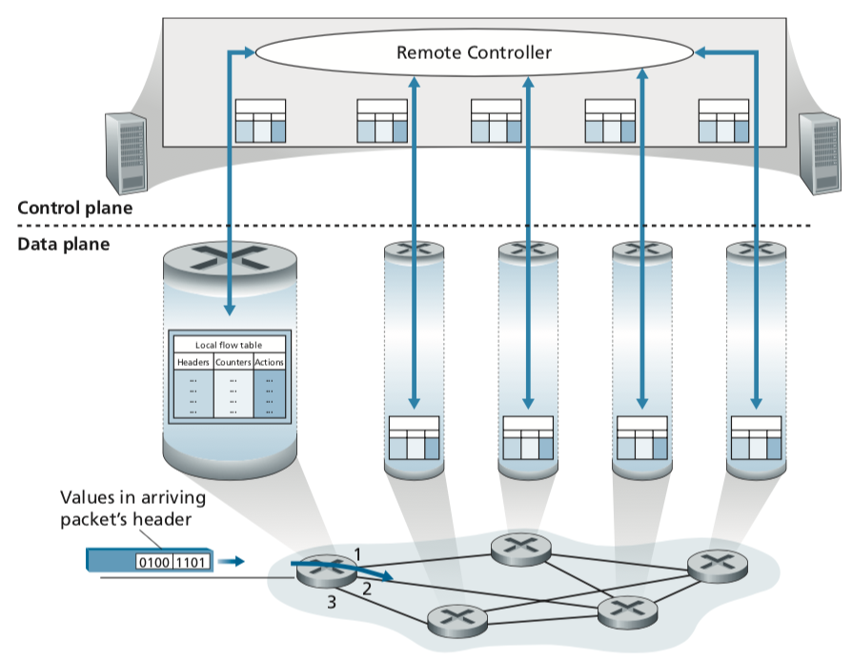
Generalized Forwarding and SDN
Overview
Generalized Forwarding:
Each packet switch contains a match-plus-action flow table that is computed and distributed by a remote controller.
Kurose, J.F. and Ross, K.W. (2021). Computer Networking: A Top-Down Approach (8th Edition). Pearson Education Limited, England. (pp. 353)
Notes:
Our following discussion of generalized forwarding will be based on Open- Flow [McKeown 2008, ONF 2020, Casado 2014, Tourrilhes 2014]—a highly visible standard that has pioneered the notion of the match-plus-action forwarding abstrac- tion and controllers, as well as the SDN revolution more generally [Feamster 2013]. We’ll primarily consider OpenFlow 1.0, which introduced key SDN abstractions and functionality in a particularly clear and concise manner. Later versions of OpenFlow introduced additional capabilities as a result of experience gained through
implementation and use; current and earlier versions of the OpenFlow standard can be found at [ONF 2020]

Slide 135
Generalized Forwarding and SDN
Overview
Generalized forwarding will be based on a standard rule → Open-Flow.
It is a highly visible standard that has pioneered the notion of the match-plus-action forwarding abstraction and controllers.
OpenFlow1.0 is used, which introduced key SDN abstractions and functionality
Kurose, J.F. and Ross, K.W. (2021). Computer Networking: A Top-Down Approach (8th Edition). Pearson Education Limited, England. (pp. 353)

Slide 136
OpenFlow: Data Plane Abstraction
flow: defined by header fields
generalized forwarding: simple packet-handling rules
Pattern: match values in packet header fields
Actions (for matched packet): drop, forward, modify, matched packet or send matched packet to controller
Priority: disambiguate overlapping patterns
Counters: #bytes and #packets
Flow table in a router (computed and distributed by controller) define router’s match+action rules

Slide 137
OpenFlow: Data Plane Abstraction
match+action: unifies different kinds of devices
Router
match: longest destination IP prefix
action: forward out a link
Switch
match: destination MAC address
action: forward or flood
Firewall
match: IP addresses and TCP/UDP port numbers
action: permit or deny
NAT
match: IP address and port
action: rewrite address and port

Slide 138
OpenFlow: Data Plane Abstraction
* : wildcard
src=1.2.*.*, dest=3.4.5.* → drop
src = *.*.*.*, dest=3.4.*.* → forward(2)
3. src=10.1.2.3, dest=*.*.*.* → send to controller

Slide 139
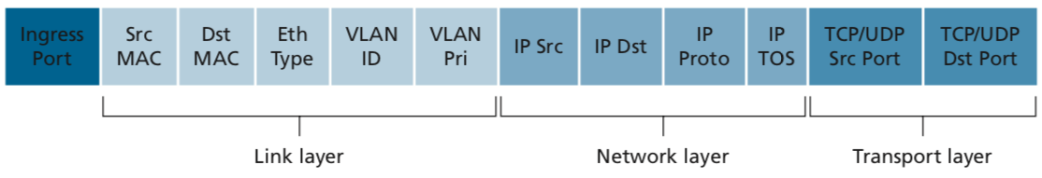
4
OpenFlow: Flow Table Entries
Rule
Action
Stats
Packet + byte counters
Forward packet to port(s)
Encapsulate and forward to controller
Drop packet
Send to normal processing pipeline
Modify Fields
Kurose, J.F. and Ross, K.W. (2021). Computer Networking: A Top-Down Approach (8th Edition). Pearson Education Limited, England. (pp. 355)
Notes:
Now I’ll describe the API that tries to meet these goals.
139

Slide 140
OpenFlow: Flow Table Entries
Examples 1
Destination-based forwarding:
Action
51.6.0.8
port6
* * * * * * * * * * *
IP datagrams destined to IP address 51.6.0.8 should be forwarded to router output port 6
Destination-based layer 2 (switch) forwarding:
Action
* * * * * * * * * * *
port3
22:A7:23:
11:E1:02
Layer 2 frames from MAC address 22:A7:23:11:E1:02 should be forwarded to output port 3

Slide 141
OpenFlow: Flow Table Entries
Examples 2
Firewall:
Action
22
Drop
* * * * * * * * * * *
Do not forward (block) all datagrams destined to TCP port 22
Action
128.119.1.1
Drop
* * * * * * * * * * *
Do not forward (block) all datagrams sent by host 128.119.1.1

Slide 142


OpenFlow: Flow Table Entries
Examples 3
Datagrams from hosts h5 and h6 should be sent to h3 or h4, via s1 and from there to s2
match
action
IP Src = 10.3.*.*
IP Dst = 10.2.*.*
forward(3)
Host h6
10.3.0.6
1
s3
controller
2
3
4
Host h5
10.3.0.5
1
s1
s2
1
2
Host h4
10.2.0.4
4
2
4
Host h1
10.1.0.1
3
3
Host h2
10.1.0.2
match
action
match
action
Host h3
10.2.0.3
ingress port = 2
IP Dst = 10.2.0.3
ingress port = 2
IP Dst = 10.2.0.4
forward(3)
ingress port = 1
IP Src = 10.3.*.*
IP Dst = 10.2.*.*
forward(4)
forward(4)

